Slide 1
Springboard Data Science Career Track - Capstone Project 3
NBA: Prediction of Game Winners
Weijung Tseng 09/01/2021

Slide 2
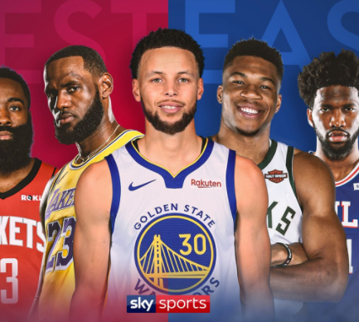
Can we beat the games like they do?
NOTE:
To change images on this slide, select a picture and delete it. Then click the Insert Picture icon
in the placeholder to insert your own image.

Slide 3
Project Objectives
Learning Objective:
This capstone project summarizes the knowledge and skills of program participants in the data science career track as demonstrated in the project workflow from data gathering, wrangling, analysis, modeling, summarizing, and recommendation for action plans.
Business Objective:
Using the findings and conclusions from this project are useful for game managers, coaches, and gamblers

Slide 4
Background
NBA is the second most popular sport in North America. It’s the 3rd most popular sport in the world.
Being able to predict game result is important.
For general managers and coaches of each team, they need to have a good prediction for each game so they can decide how to best utilize their players. And when it’s getting closer to the end of a season, they can see if they have a shot to the playoffs or if they can rest their star players to avoid them getting injured.
For teams that are making it to playoffs, it’s essential for them to predict game results to see which seeds they are likely to be.
NBA attracts millions of gamblers to bet on the game results, so the sport betting market of NBA is quite huge. And therefore, it’s not only interesting but also lucrative to know if we can find a way to beat the house.

Slide 5
Methodology
The following methodology was adapted to predict game winners in 2019-2020 seasin:
Dataset: Identify where to find the required data and data retrieval
Data Wrangling: Once the data is identified and retrieved, basic data preprocessing and quality control are conducted
Data Exploration: When the data is ready for exploration, apply statistical methods to identify data clusters, correlations, and trends
Data Modeling with Machine Learning for Prediction: With basic understanding of the data, more advanced data analytics of machine learning is applied to the data to build predictive models
Summary: conclusions and recommendations

Slide 6
Dataset
There were two dataset I used in this study: traditional and advanced data
Traditional data: the data was pulled from https://www.nba.com/stats/teams/boxscores/?Season=2019-20&SeasonType=Regular%20Season&sort=gdate&dir=-1
Traditional data contained each team’s field goal percentage, 3-points percentage, free throw percentage, steals, block, etc in each game.
Advanced data: the data was pulled from https://www.nba.com/stats/teams/boxscores-advanced/?Season=2019-20&SeasonType=Regular%20Season&sort=gdate&dir=-1
Advanced data contained each team’s offensive rating, defensive rating, assistance ratio, EFG%, TS%, PIE, etc in each game.

Slide 7
Data Wrangling
Any extraneous data was removed
Rows and Columns containing only redundant data
Columns that held only descriptive information of the complaint
Features for Data Exploration and Machine Learning were identified and prepared
Converting and combining datetimes
Adding features:
Adding features to show win rate
Calculate rolling (window = 5) and season data for each stats

Slide 8
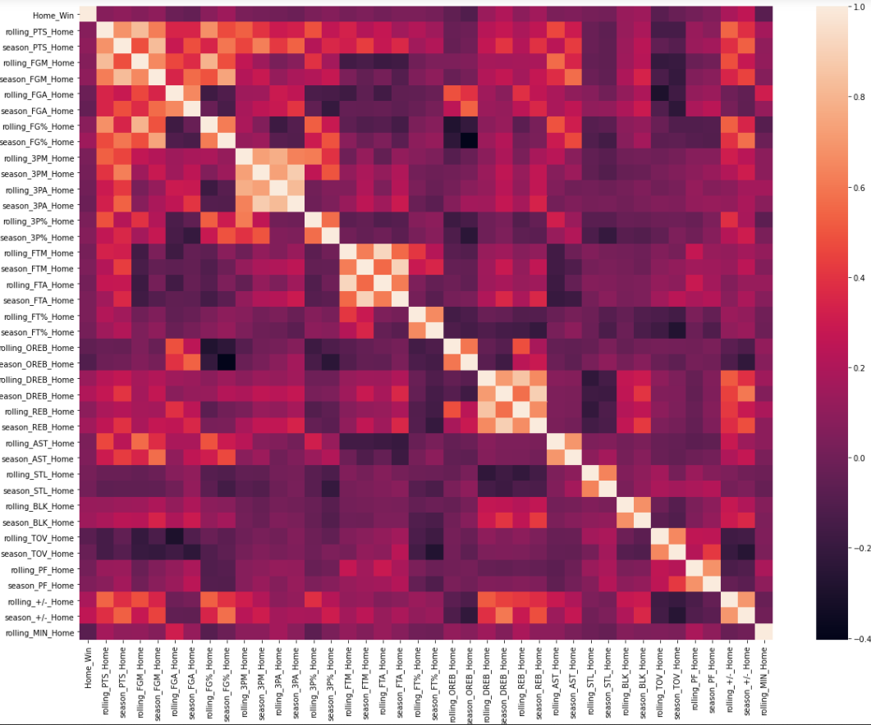
Data Exploration
Correlation Matrix

Slide 9
ML – Algorithms Used
As the goal of the data analysis is to determine game winners, a supervised machine learning classification method seems appropriate.
6 different models were built:
SVC
Random Forest
Logisic Regression
Decision Tree
Gradient Boosting
Naïve Bayes

Slide 10
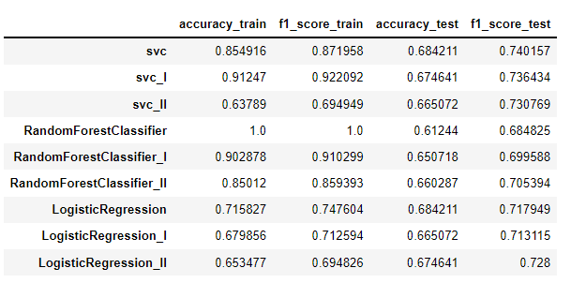
Results
The highest accuracy of my model is at 68.4% comparing with the baseline at 55.0%. Both svc and logistic regression models tied at that percentage. Hyperparameter tuning didn’t help on accuracy.
Also, selecting more import features to build a new model didn’t help either.
Most important features:
season_PIE_Home
season_Win_Ratio_Home,
season_DREB_Home
“Home” stats are more important than “visitor” stats, and “season” stats are more important than “rolling” stats

Slide 11
Recommendation for clients to use the findings
Season’s stats are more important comparing with rolling stats, so for a team to predict their game result, they should look at the whole season’s stats instead of recent stats.
Home team’s stats are more important than visitor team’s stats. And therefore, when a team play a home game, whether they win or not are more dependent on their own stats instead of their opponent’s.
The best accuracy I could get was still less than 70%, which means historical data still couldn’t explain game result more than 30% of the time. Players and coaches should get frustrated knowing the odds are against them because there are still rooms to turn things around. And people who put wager on game should pay closely attention on the first half of the game, they may consider bet on a different team at half time because if players are playing significantly different from their previous games, they are likely to change the game result

Slide 12
Ideas for future studies
Future studies should look at each player’s stats as well. Rooster can vary from game to game due to injury or other reason and that should be put into consideration.
Player combination seems to matter as well, different players combination can contribute significantly different depend on whether they have good or bad atmosphere.
Officials matter sometimes because the way they officiate games may lead to different game result.

